Slide 1

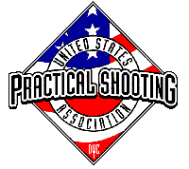
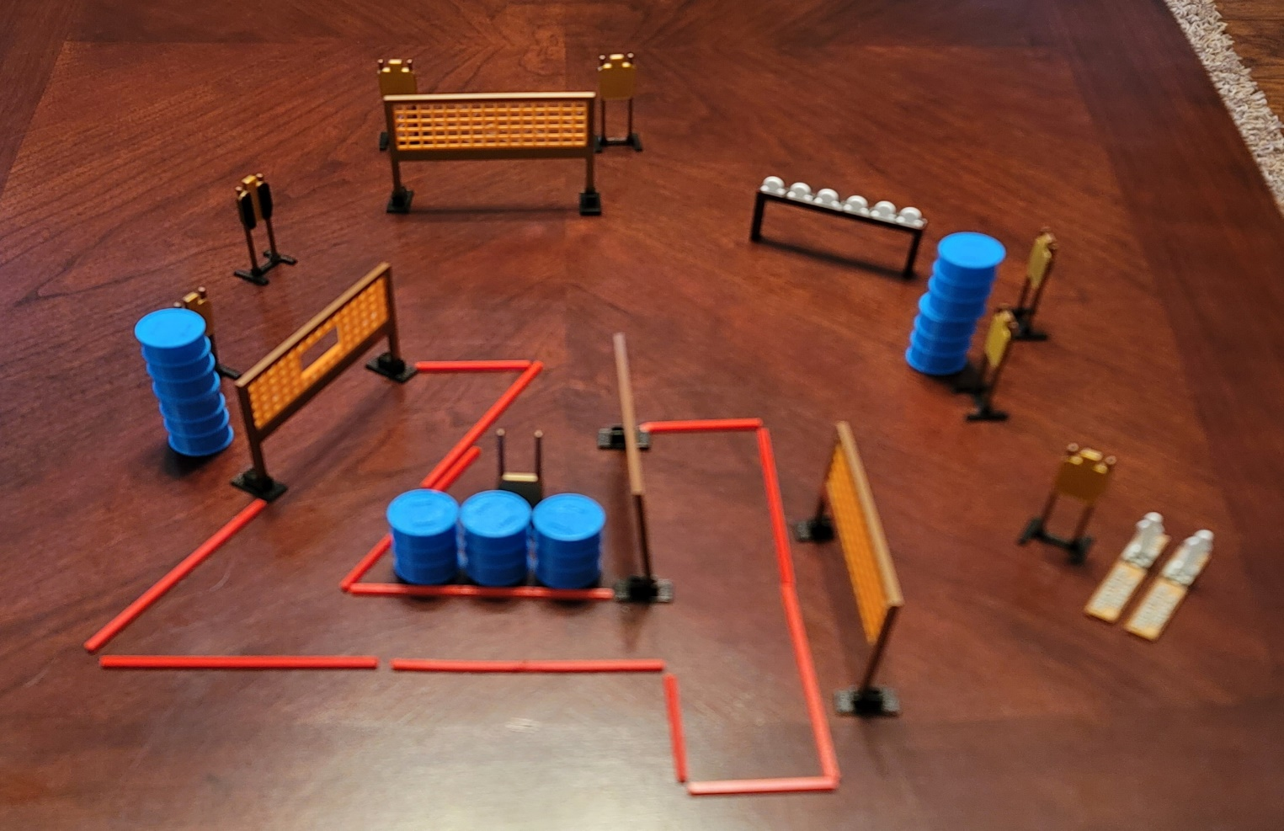
 | Dothan Gun Club – USPSA Match Too Close, Too Far Course Designer : Eric Henwood
Round Count 23 rounds 8 USPSA 5 falling plates, 2 colt poppers
Equipment List 8 wall feet 3 medium fault lines Plate rack (paint one as hard cover) 1 tux 7 targets

Slide 2
Too Close, Too Far
Written Stage Briefing
Too Close, Too Far is a 23 round, 115-point, Comstock course of fire. There are 8 USPSA targets and 7 steel. The best 2 hits on cardboard will score and steel must fall to score.
Handgun start position is anywhere completely outside the shooting area, wrists below belt. Handgun is loaded and holstered.
PCC start position is anywhere completely outside the shooting area, stock on belt. Loaded carbine is held with both hands.
On the audible start signal, engage targets as they become available from within the shooting area.

